Slide 1
Additive Manufacturing (or 3D Printing) (or Rapid Prototyping) AM methods, and concurrent barriers and challenges
MAE 540

Slide 2
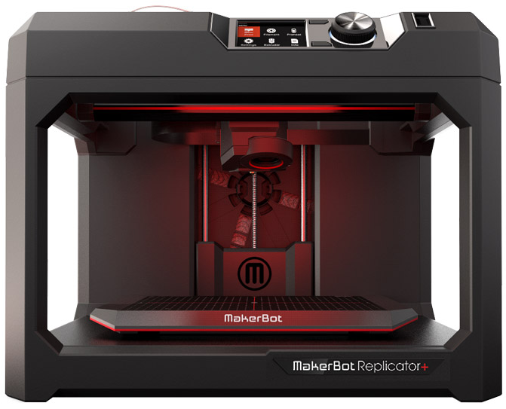
AM methods
Material extrusion aka Fused Deposition Modeling (FDM): create layers by mechanically extruding molten thermoplastic material (e.g., ABS or PLA, and processing ceramic and metal pastes) onto a substrate.
Price: ~$1000

Slide 3
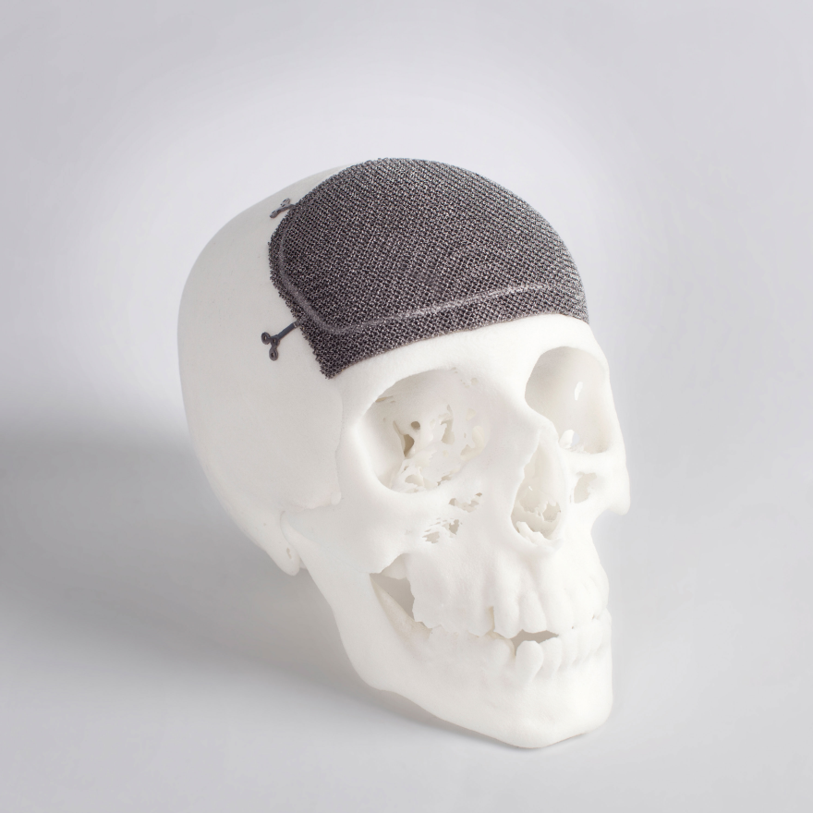
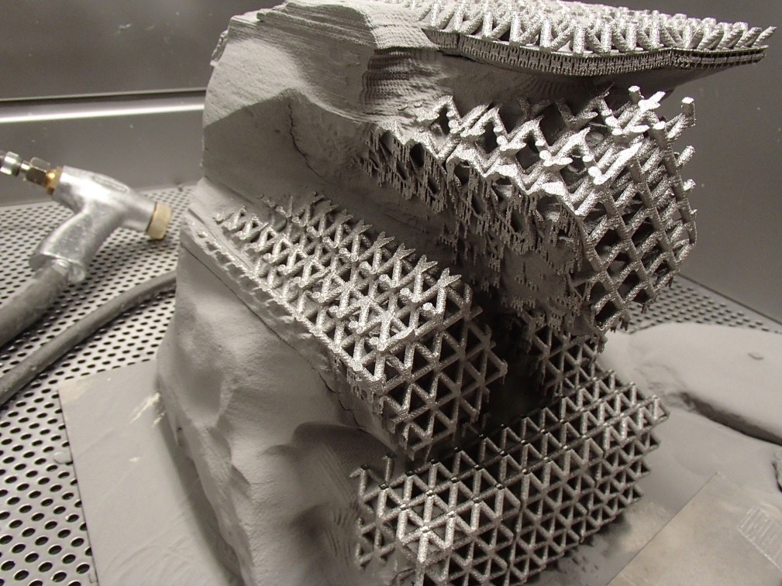
AM methods
Powder bed fusion (Direct metal laser sintering, selective laser melting and electron beam melting): use an energy beam (e.g. laser or electron beam) to selectively melt a powder bed.
Price: ~$1000,000

Slide 4
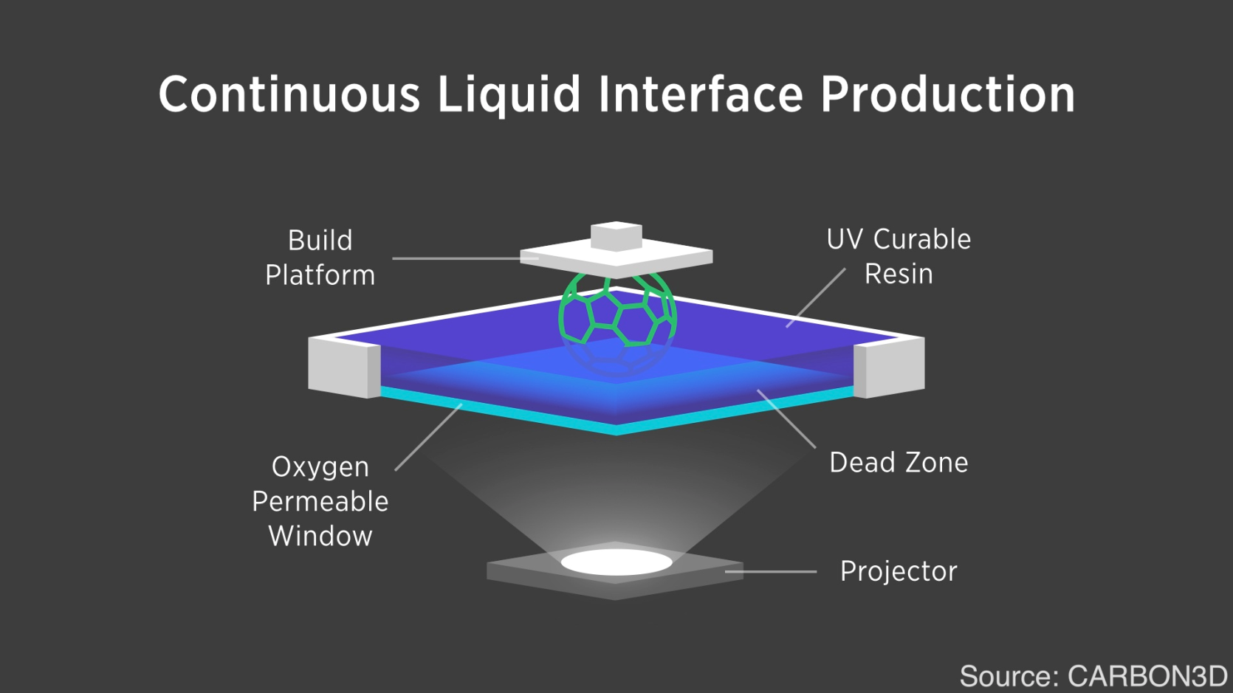
AM methods
Vat photopolymerization aka stereolithography method (SLA): ultraviolet laser was used to selectively polymerize the UV curable resins to create a layer of solidified material, limited to photopolymers
Price: ~$1000

Slide 5
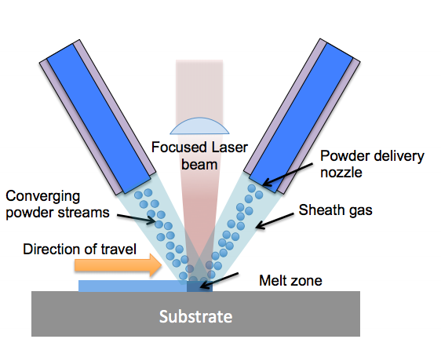
AM methods
Direct energy deposition: metallic powder or wire is fed directly into the focal point of an energy beam to create a molten pool
Price: $?

Slide 6
AM methods
Printing circuits, sensors, and batteries through Direct Write
Panesar et al. (2014) Design Optimization Strategy for Multifunctional 3D Printing

Slide 7
AM Material Cost
http://www.sciaky.com/additive-manufacturing/wire-am-vs-powder-am
Material Feedstock | Titanium 6AI-4V | Tantalum | Inconel 625 | Stainless Steel 316
Wire—0.035" Diameter (0.9 mm) | $58/lb. | $545.30/lb. | $26.73/lb. | $5.19/lb.
Wire—0.045" Diameter (1.1 mm) | $54/lb. | $545.30/lb. | $23.30/lb. | $4.63/lb.
Wire—0.062" Diameter (1.6 mm) | $50/lb. | $524.88/lb. | $22.17/lb. | $4.57/lb.
Wire—0.093" Diameter (2.4 mm) | $48/lb. | $502.30/lb. | $21.43/lb. | $4.81/lb.
Wire—0.125" Diameter (3.2 mm) | $45/lb. | $438.96/lb. | $21.02/lb. | $4.75/lb.
Wire—0.156" Diameter (4.0 mm) | $44/lb. | $438.96/lb. | N/A | $4.69/lb.
Powder—AM Grade | $120/lb. | $522/lb. | $48/lb. | $10/lb.

Slide 8
Classification of AM
Classification of additive manufacturing processes by ASTM International (2013)

Slide 9
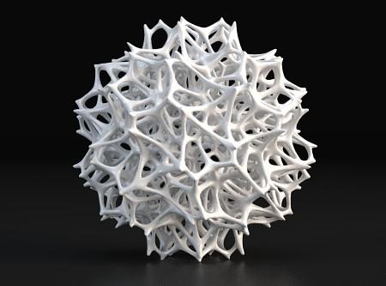
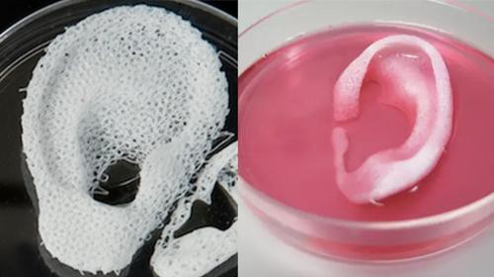
Concurrent barriers and challenges
Personal fabrication vs. mass manufacturing
Suitable products for AM: Customized, low-volume, complex, e.g., aerospace/high-end automotive components, bio-medical products, jewelry, home accessories.

Slide 10
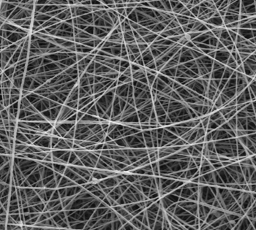
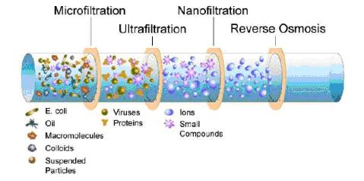
Concurrent barriers and challenges
Building scalability vs. layer resolution
Layer resolution for commercially-available AM systems: ~0.1mm (Makerbot Replicator 2) to 25mm
Full spectrum of build sizes in research
Lee and Kim (2014)
Building nanoscaffolds, nanofilters, nanorobots, and nanoelectrodes with electrospun polymer nanofibers

Slide 11
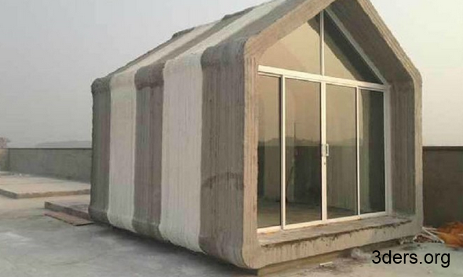
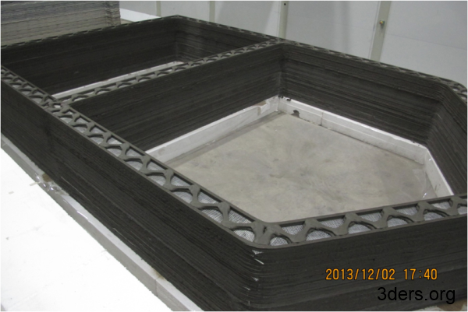
Concurrent barriers and challenges
Building scalability vs. layer resolution
Layer resolution for commercially-available AM systems: ~0.1mm (Makerbot Replicator 2) to 25mm
Full spectrum of build sizes in research
Daicho et al. (2013) 3D carbon microstructures
Khoshnevis et al. (2006) Mega-scale fabrication

Slide 12
Concurrent barriers and challenges
Material heterogeneity and structural reliability
Limited AM materials
Anisotropic mechanical properties

Slide 13
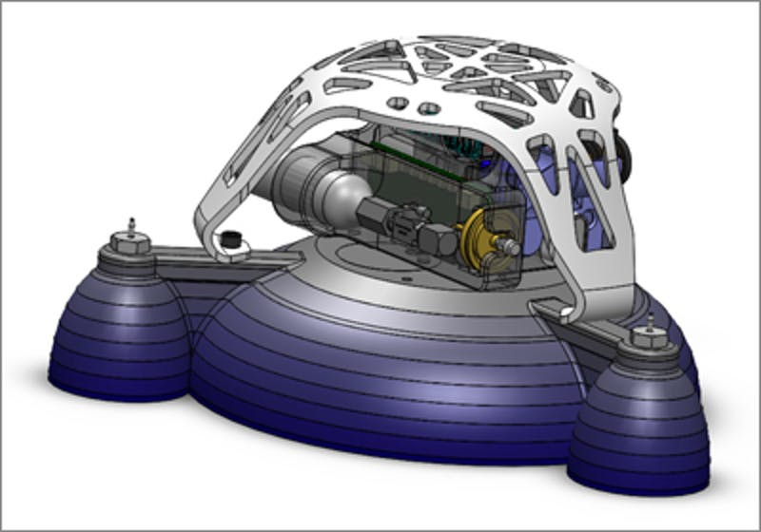
Concurrent barriers and challenges
Material heterogeneity and structural reliability
Functionally-graded materials have uncertain behavior at the material interfaces

Slide 14
Concurrent barriers and challenges
Use of support material
(a) Build-direction. (b) Subtended angle. (c) Support length. (d) Support volume.
Mirzendehdel et al. (2016)
Effect of support constraint on optimized design

Slide 15
Concurrent barriers and challenges
Removal of support material
Before etching
After etching
Lefky et al. (2016) Dissolvable metal supports for printed metal parts
(from Dr. Owen Hildreth’s group)

Slide 16
Gao et al. (2015) The status, challenges, and future of additive manufacturing in engineering

Slide 17
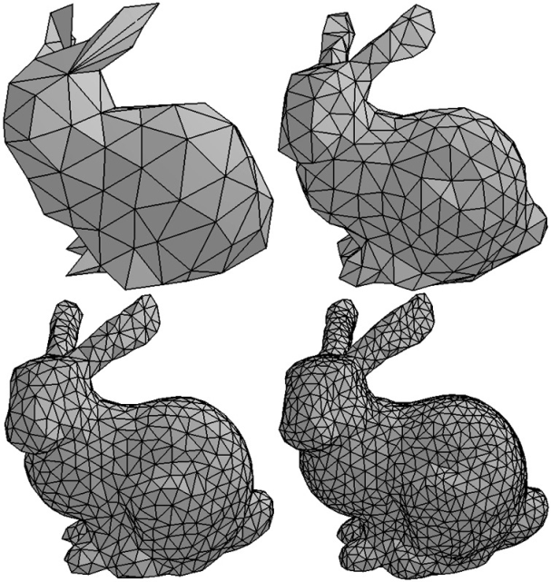
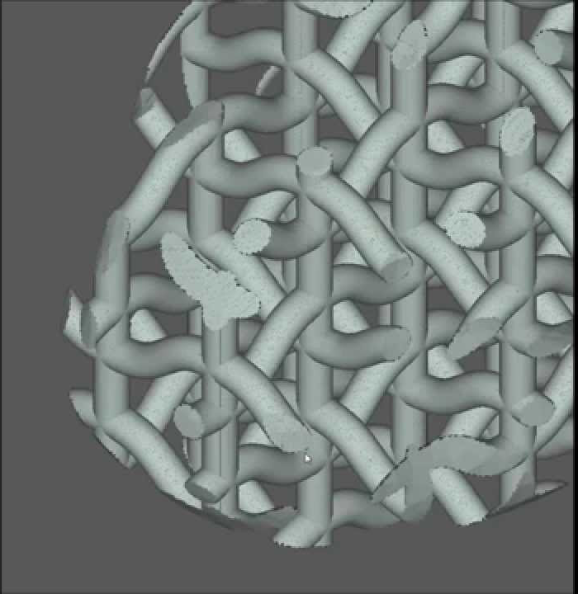
What’s next?
Geometry design for AM
3D representations suitable for editing, analyzing and printing
voxel
mesh
LDNI

Slide 18
What’s next?
Geometry design for AM
Geometric processing: hollowing and thickening, support generation
Structure optimization, model validation
Multi-material representation and analysis
4D printing, origami sheets
New design tools: Sketch based, gesture based
3D optical scanning
Material-efficient and environment-friendly AM

Slide 19
3D marketplaces
Shapeways: Design, Prototype, Buy and Sell custom products; The world's largest online 3D Printing Service, Community and Marketplace.
Thingiverse: Download our files and build them with your lasercutter, 3D printer, or CNC.
Sculpteo: offers everyone rapid online 3D printing services.
Onshape: full-cloud 3D CAD system that lets everyone on a design team simultaneously work together using a web browser, phone or tablet.

Slide 20
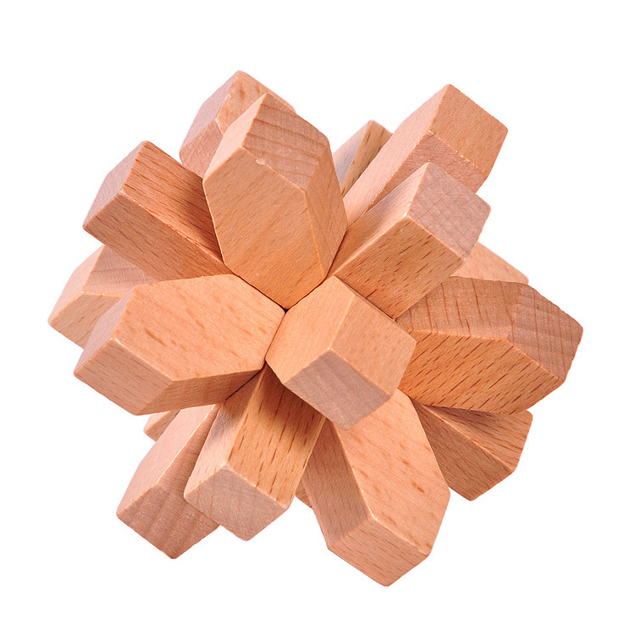
Burr Puzzles and ancient wood joinery
Burr Puzzle: interlocking puzzle consisting of notched sticks, combined to make one three-dimensional, usually symmetrical unit.

Slide 21
Burr Puzzles and ancient wood joints
Commonly used in architectures in Asian countries

Slide 22
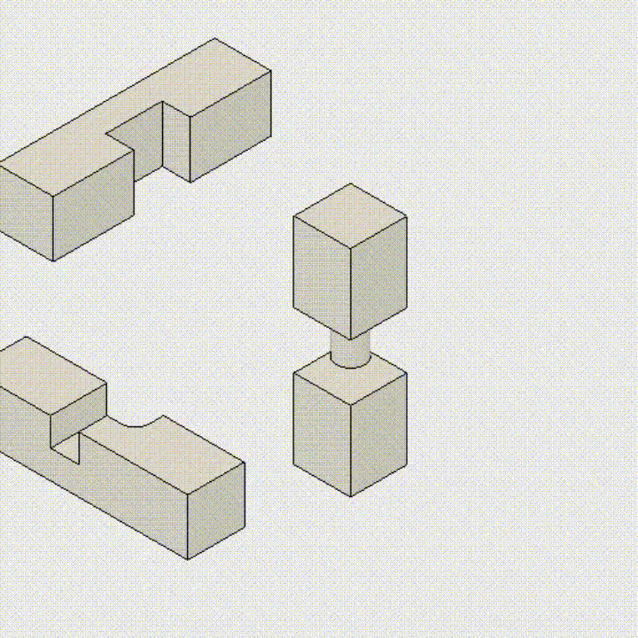
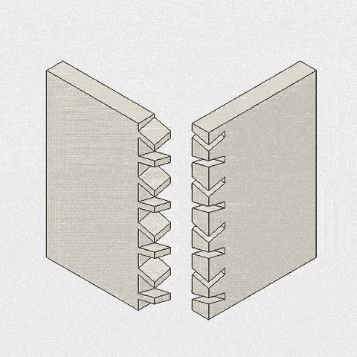
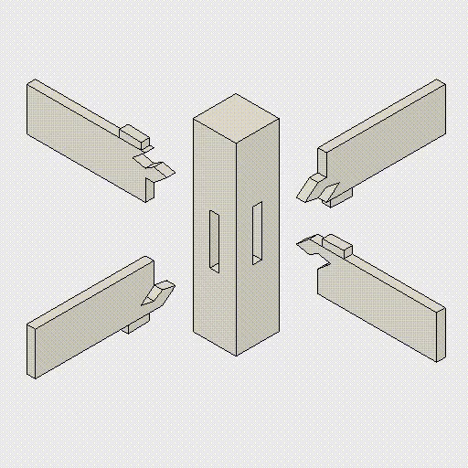
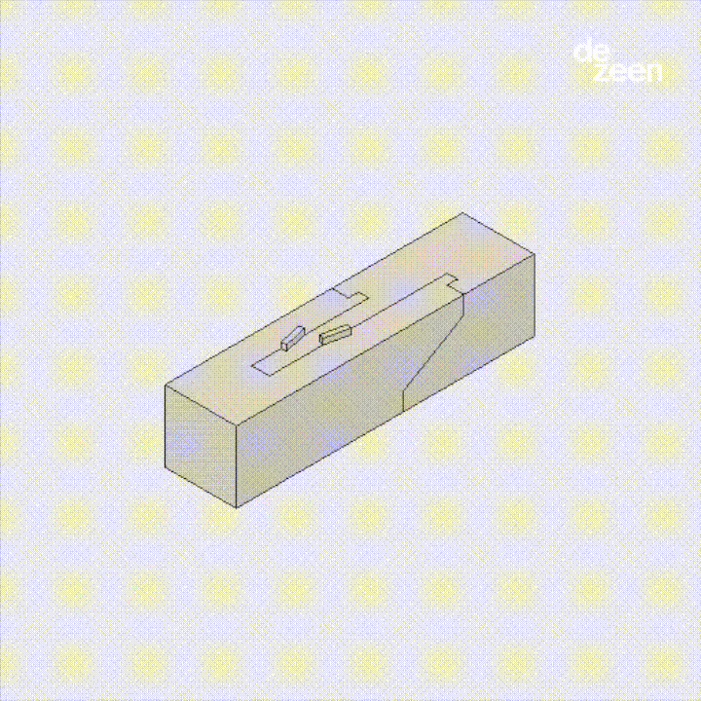
Burr Puzzles and ancient wood joinery

Slide 23
3D printing Burr Puzzles
Song et al. (2015) Printing 3D Objects with Interlocking Parts

