Slide 1
Analytical Design
Max Yi Ren
MAE540 Advanced Product Design

Slide 2
Things to cover
Response surface methods
Design of experiments
Sensitivity analysis
Design optimization
Topology optimization

Slide 3
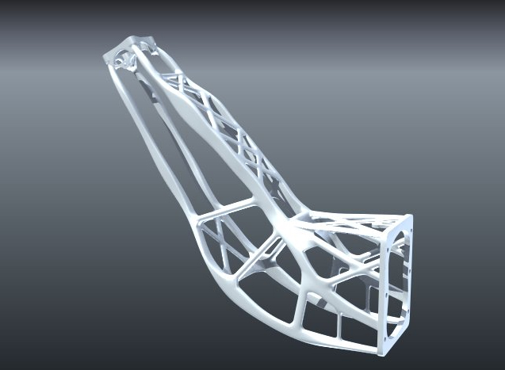
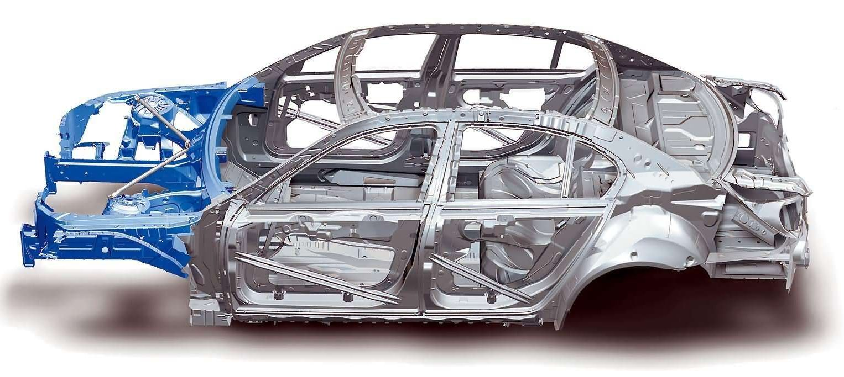
Design refinement requires more than intuition
Topology optimization

Slide 4
Design refinement requires more than intuition
Parametric design
Optimized Airfoil Interior, Jacob Maneth, Bret Wainwright, Peter Harper, MAE598 Spring 2016
BAJA car frame design, Akshay Murkute, Anket Hirachand Marathe, Ivan Rodrigues, Karthik Ramagiri, Kaushik Munusamy Kabilan, MAE598 Spring 2016
Rocket geometries for 1,2,3 Astronauts Compared to the Saturn V, Matthew Catlett, Jenna Lynch, Adrian Maranon, Trevor Slawson, MAE598 Spring 2015

Slide 5
Design refinement requires more than intuition
Configuration design
Voltec, GM 2016

Slide 6
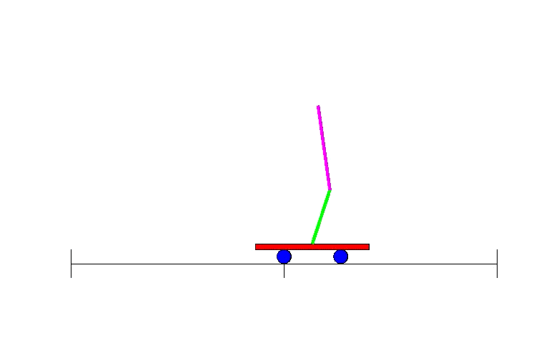
Design refinement requires more than intuition
Controller design
Inverted Pendulum
Atlas, Boston Dynamics
Sensor design
Battery thermal sensor deployment
Samad, PhD thesis, Umich 2016

Slide 7
Analytical design is about “optimization”
minimize_{x} f(x)
subject to: h(x) = 0, g(x) <= 0

Slide 8
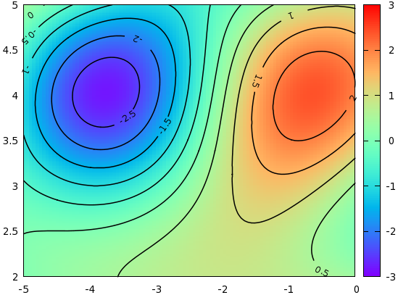
Variables and the Objective
x₁
x₂

Slide 9
Variables, Objective & Constraints
Feasible Design Space
Constraint
x₁
Variable 1
x₂
Contour of the Objective
Variable 2

Slide 10
Common issues in the optimization of engineering systems
No analytical forms for the objective and/or constraints
Objective
Variable

Slide 11
Common issues in the optimization of engineering systems
Probabilistic responses
Objective
Variable

Slide 12
Common issues in the optimization of engineering systems
Multiple objectives
Multiple local solutions and other computational issues
Better
Reality
Better
Local minimum
Objective
Global minimum
Variable

Slide 13
Activity 1
From a pizza, cut the largest rectangular piece. How does it look like?
Dropping a frictionless ball from point A, which curve achieves the shortest time for it to reach point B?
A
B

Slide 14
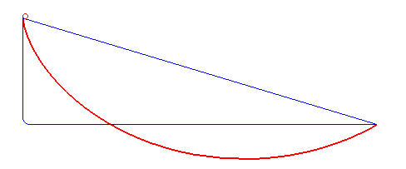
Activity 1
From a pizza, cut the largest rectangular piece. How does it look like?
Dropping a frictionless ball from point A, which curve achieves the shortest time for it to reach point B?

Slide 15
Overview
Response surface methods
Design of experiments
Sensitivity analysis
Design optimization

Slide 16
Response Surface Method
Response surface
An analytical surface that approximates the underlying ground truth (which is expensive to get)

Slide 17
Response Surface Method
Standard Response Surface: uses a polynomial surface. Use this when you have lots of data and the change in objective is smooth.
Kriging: non-parametric, automatically fits through all data points. Use this method when your data is highly nonlinear and limited, and you want your model to fit right through your data (i.e., you trust your simulation results).
Non-parametric Regression: Support Vector Regression. The model does not fit through the data. Use this method when your data is highly nonlinear, and you don’t need your model to fit right through your data.
Neural Network: slow in training and may end up with a different model each time you train. Use this method when your data is highly nonlinear but you have lots of them, and you don’t need your model to fit right through your data.
Sparse Grid: This method goes with the corresponding DOE method. It is similar to Kriging in that it handles highly non-linear objectives. It does so by adaptively sampling in the most uncertain areas of the design space, and thus may reduce the number of samples needed. Use this method when the objective is highly nonlinear and you cannot afford many simulations

Slide 18
Design of experiments
What is DOE?
A way to smartly scatter a limited amount of samples in the variable space, so that a response surface can be built with low uncertainty

Slide 19
Design of experiments
What is DOE?
A way to smartly scatter a limited amount of samples in the variable space, so that a response surface can be built with low uncertainty
Recommendation on ANSYS options
Latin Hypercube Sampling and Optimal space filling: number of samples is independent from number of variables. Good for highly nonlinear functions.
Sparse grid: goes with sparse grid optimization. Good for highly nonlinear functions.
Kriging with auto-refinement: Similar to sparse grid
Central Composite Design: Good for quadratic functions

Slide 20
Activity 2
Create an ANSYS model
Run DOE and response surface
Check model fitness and see how DOE and response surface settings affect the fitness
NOTE: Use verification points!

Slide 21
Verification
The goodness of a response surface model is determined by its predictability, i.e., whether it can correctly predict the performance of new designs
Predictability is related to two things:
Training error: The goodness of fit on training data
Model complexity: The number of parameters in the response surface model
For non-parametric models, e.g., Kriging, Support Vector Regression, and Neural networks, the training error is low, model complexity is high.
Simply using the training error to measure the goodness of a response surface model can lead to overfitting, i.e., the model fits well to the training data, but has no predictability.
Therefore, use verification (also called validation) points to measure the goodness of model is highly recommended!
Use verification points to double check!
Objective
Objective
Perfect fit?
Variable
Variable

Slide 22
Optimization
Screening: Randomly sampling the space and pick out the good ones. Use this as an initial trial to make sure everything is setup correctly, e.g., does your simulation give reasonable results?
Multiobjective Genetic Algorithm (MOGA): Simultaneously find Pareto-optimal designs. Use this when you have multiple objectives. This is not the only choice for this situation though, see discussion above.
Nonlinear Programming by Quadratic Lagrangian (NLPQL): Fast local search. Use this when (1) there is only one objective (but you can set other objectives as constraints), (2) the simulation does not take too long (in minutes), (3) the number of variables is small (less than 10).
Mixed-Integer Sequential Quadratic Programming (MISQP): Similar to NLPQL, but allows integer variables. Note that the addition of integer variables will often significantly increase the computation time.
Adaptive Single-Objective Optimization (ASO): This method uses Optimal Space Filling for DOE, Kriging as a response surface, and MISQP for finding local optimal solutions from the response surface. Use this when the evaluation of objective/constriants are expensive and you have limited budget/time for optimization.
Adaptive Multi-Objective Optimization (AMO): Similar to ASO, this one uses Kriging and MOGA.

Slide 23
Activity 3
The brake design problem has the following objectives:
Design a brake disc for emergency braking conditions with minimal volume
Minimize the maximum stress in the brake disc
Maximize the first natural frequency of the brake disc
Minimize the maximum temperature in the brake disc
For the brake design problem, which solver will you use?

Slide 24
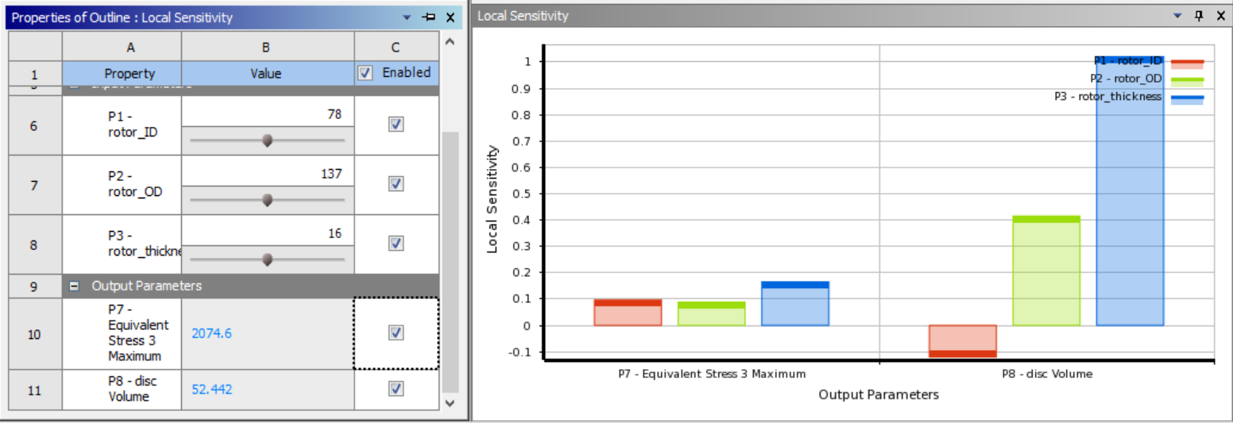
Sensitivity Analysis
Sensitivity analysis has several meanings
Local sensitivity of the objective wrt variables
Objective
Variable

Slide 25
Sensitivity Analysis
Sensitivity analysis has several meanings
Sensitivity of the optimal objective wrt constraints
i.e., how much can the optimal objective improve if the constraint is relaxed?
Objective
Variable

Slide 26
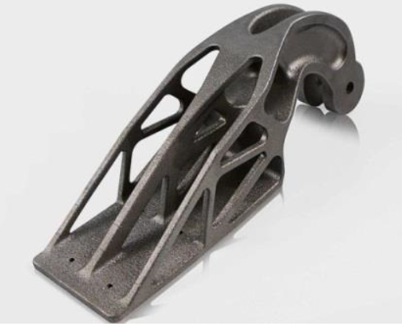
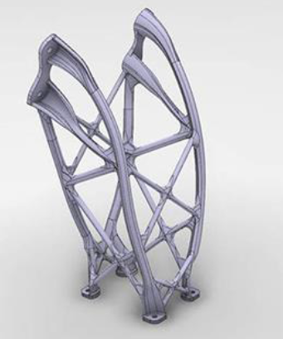
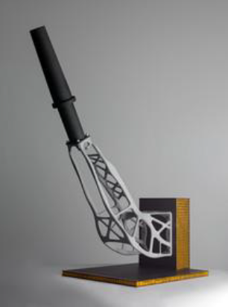
Topology Optimization
Airbus A320 nacelle hinge bracket by EADS and Airbus
An antenna bracket for a Sentinel-1-Satellite by RUAG
A structural bracket for Eurostar
E3000 satellites by Airbus Defense and Space in UK

Slide 27
Topology Optimization
The MBB beam problem: Find the optimal material distribution to minimize compliance, w/ constraint on total material.
Young’s modules
density

Slide 28
Topology Optimization
The MBB beam problem: Find the optimal material distribution to minimize compliance, w/ constraint on total material.
Compliance
Volume fraction
FEA

Slide 29
Activity 4
What is the minimal-compliance topology for the following boundary conditions?

Slide 30
Topology Optimization
The MBB beam problem: Find the optimal material distribution to minimize compliance, w/ constraint on total material.
Update scheme:
Where:

Slide 31
Useful Topology Optimization codes
TopOpt group at DTU has a line of software/app that you can use, including MATLAB codes: http://www.topopt.dtu.dk
Note: For Windows version of the software (2D/3D), you might need to follow the instruction at the bottom of http://www.topopt.dtu.dk/?q=node/903 and download “acml-6.1.0.33-ifort64.zip” from the link there.
Top3d by Liu and Tovar is an easy to use MATLAB code for 3D geometry: https://top3dapp.com/
Note that all above are for compliance minimization and elastic material only!

Slide 32
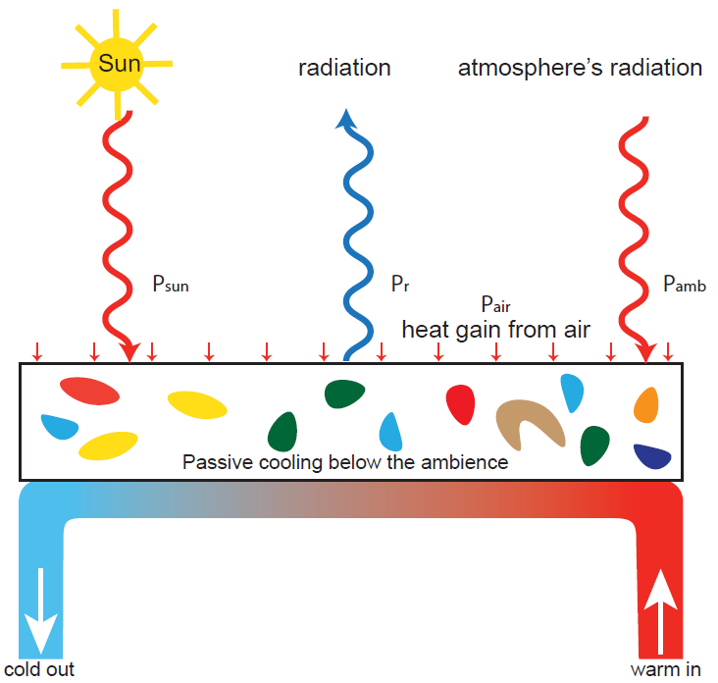
Computational Material Design
Topology optimization -> Microstructure Design
Example: Passive radiative cooling without external energy
Design a microstructure as a broadband mirror for solar light and a strong thermal emitter in the atmospheric transparency window

Slide 33
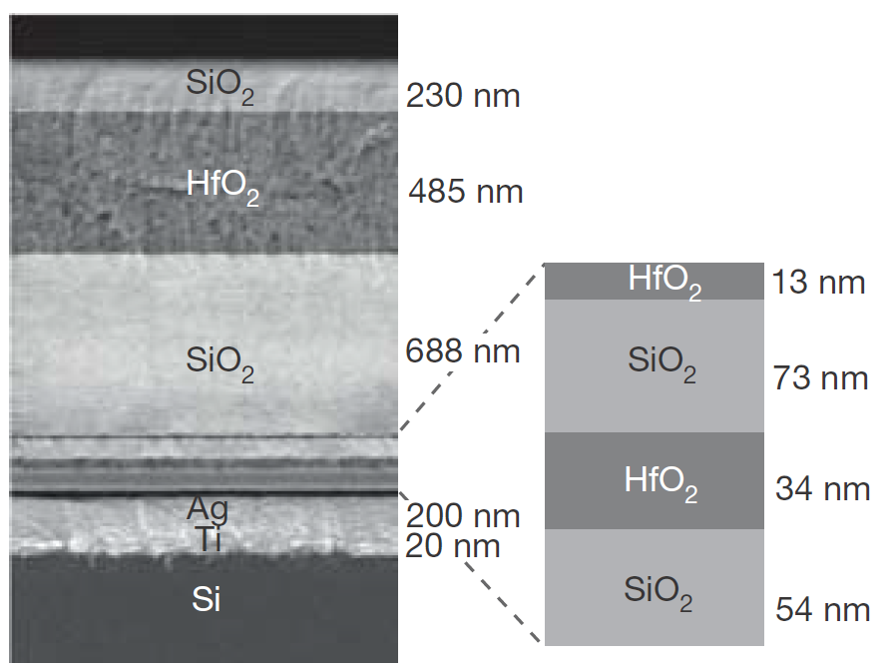
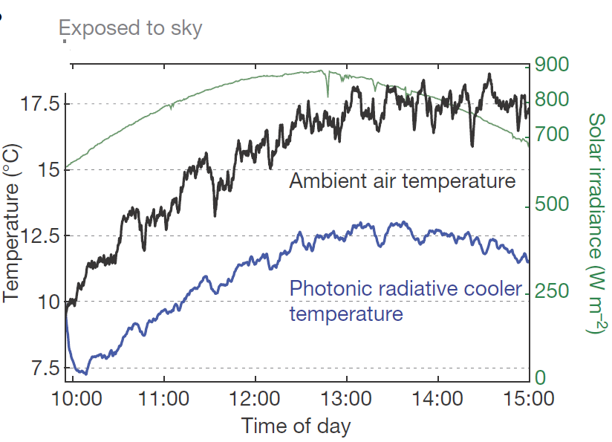
Computational Material Design
Passive radiative cooling without external energy
Aaswath P Raman, Marc Abou Anoma, Linxiao Zhu, Eden Rephaeli, and Shanhui Fan. Passive radiative cooling below ambient air temperature under direct sunlight. Nature, 515(7528):540–544, 2014.

Slide 34
Computational Material Design
Optimal nanostructure design
Wang et al. “Highly Efficient Light-Trapping Structure Design Inspired By Natural Evolution”, Nature, 2013
Optimized periodic nanostructure for light trapping in a thin-film solar cell

Slide 35
Computational Material Design
Optimal polymer nanocomposite design
Optimization through response surface method

Slide 36
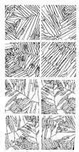
Computational Material Design
Metallic alloy microstructure design
What design representation?
Encoding
Low Dimensional Feature Space
Reconstruction
Alloy microstructure through laser sintering

Slide 37
Computational Material Design
What are the variables in material design?
Traditional statistical method works when the material can be assumed to be Markovian
Bostanabad et al., Stochastic microstructure characterization and reconstruction via supervised learning, Acta Materialia (2016)
Cang et al., Microstructure Representation and Reconstruction of Heterogeneous Materials via
Deep Belief Network for Computational Material Design, Journal of Mechanical Design (2017)

Slide 38
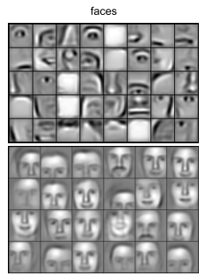
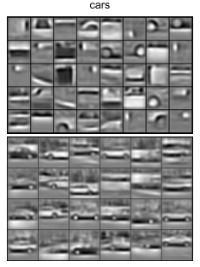
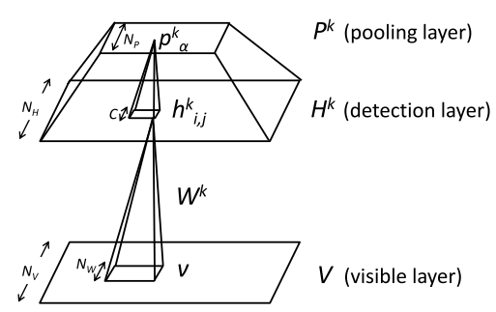
Computational Material Design
Solution: Unsupervised learning (feature extraction)
Use Convolutional Restricted Boltzmann Machine (or autoencodings) to extract the features
Local features
Global features
CRBM structure
Lee and Ng (2011)

Slide 39
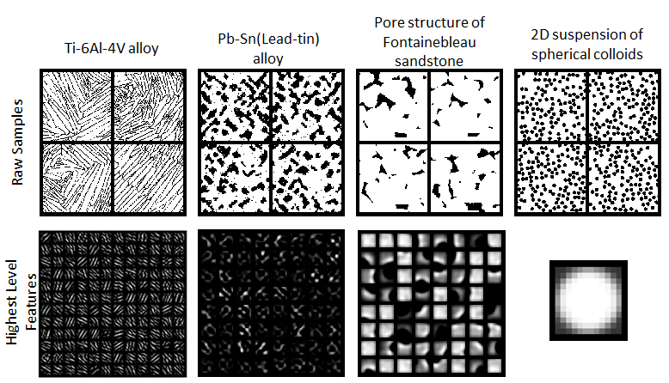
Computational Material Design
Solution: Unsupervised learning (feature extraction)
Cang et al., Microstructure Representation and Reconstruction of Heterogeneous Materials via
Deep Belief Network for Computational Material Design, Journal of Mechanical Design (2017)

Slide 40
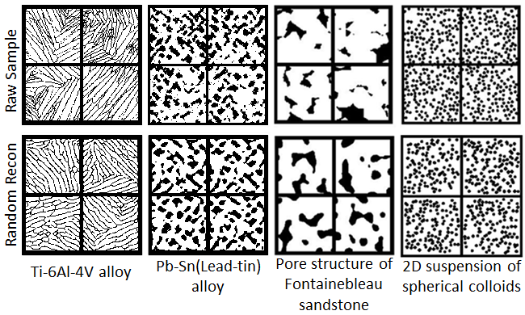
Computational Material Design
Reconstruction by inverse convolution
Cang et al., Microstructure Representation and Reconstruction of Heterogeneous Materials via
Deep Belief Network for Computational Material Design, Journal of Mechanical Design (2017)

