Slide 1
Origami and Soft Robotics
MAE 540

Slide 2
Origami (折紙)

Slide 3
Origami Circle Packing
Flaps: Basic components of an origami
Flap
Space efficiency:
Corner flap > Edge flap > Middle flap
Robert Lang, Origami Design Secrets

Slide 4
Origami Circle Packing
Origami design = Circle packing
Constraints
No overlap
Symmetric
Variable radius
Objective
Larger radius = larger origami
Robert Lang, Origami Design Secrets

Slide 5
Origami Circle Packing
Optimal packing for N=1…9
Robert Lang, Origami Design Secrets

Slide 6
Origami Circle Packing
Possible tarantula crease patterns
Robert Lang, Origami Design Secrets

Slide 7
Muira-ori
Optimal calculated origami tessellations
a,g, Logarithmic spiral—zero Gauss curvature (generalized cylinder).
b,h, Sphere—positive Gauss curvature.
c,i, Hyperbolic paraboloid—negative Gauss curvature.
d,j, Pill—cylindrical waist with positively curved caps.
e,k, Candlestick—cylindrical waist with negatively curved caps.
f,l, Vase—positively curved base with negatively curved neck
Dudte et al. 2016

Slide 8
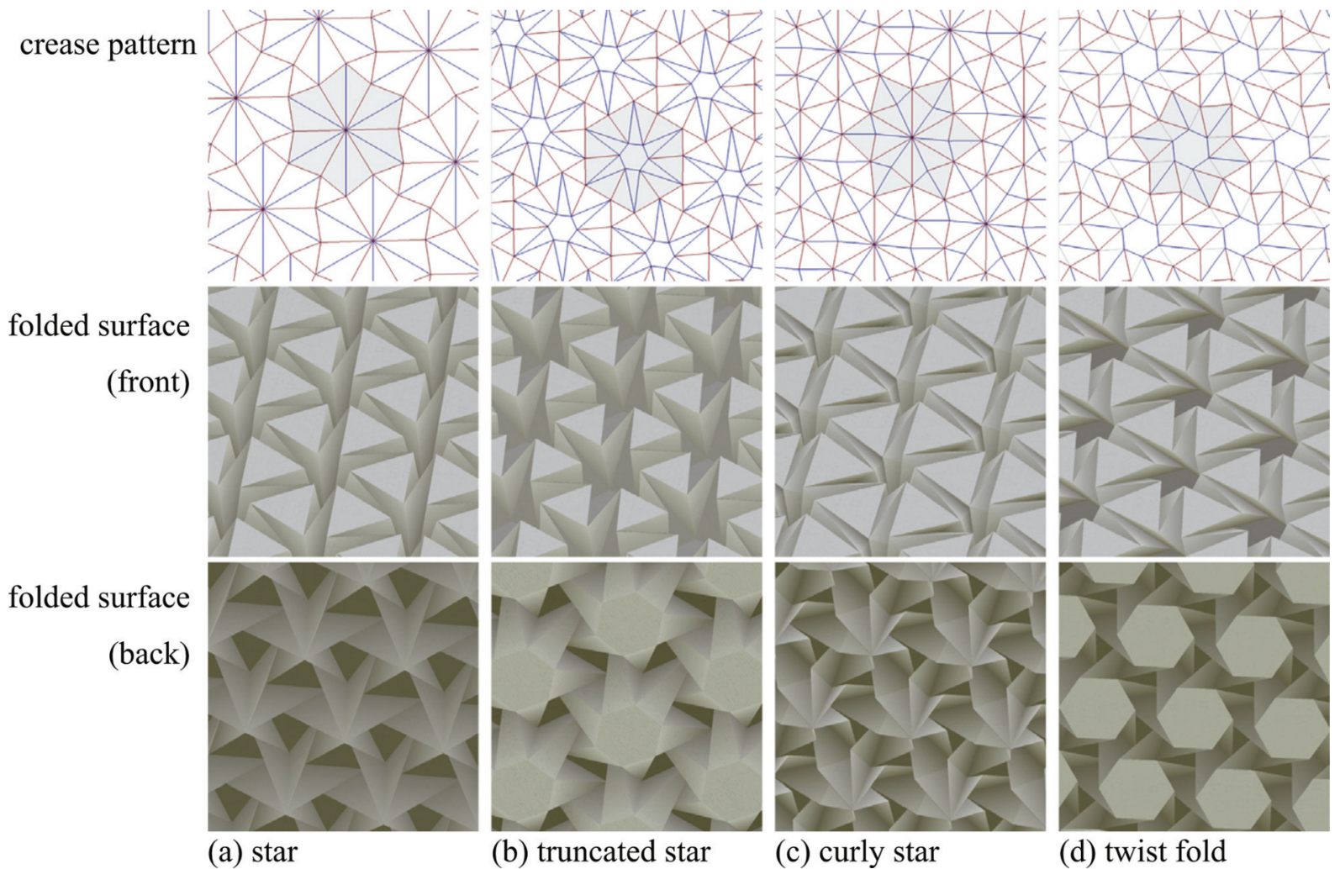
Resch’s Pattern
Tachi, 2013

Slide 9
Resch’s Pattern
Tachi, 2013

Slide 10
Resch’s Pattern
Tachi, 2013

Slide 11
Origami activation mechanism - Thermal
Sheet with shape memory alloy hinges, Hawkes et al, 2010
Shape memory polymer-based self-folding structures morphed under uniform heating,
Tolley et al, 2013

Slide 12
Origami activation mechanism - Chemical
Folding using a mixture of chemical components. By controlling the ratio between the two components of this “active” layer, different degrees of folding were achieved.
Guan et al. 2005

Slide 13
Origami activation mechanism – Electrical/Magnetic
(a) A self-folding sheet with dielectric elastomer actuator under no applied electrical field (left) and with applied electrical field (right)
(b) Photo series of a biomorphic origami robot showing the robot translating using accordion-like movement activated via electrically-induced folds (c) Magnetically induced folding of a PDMS-MAE box under zero magnetic field (left) and under non-zero magnetic field (right)

Slide 14
Origami mechanical properties
Photographs of a Miura-ori with complex defect structures and experimental demonstration of a programmable modulus
Silverberg et al. 2014

Slide 15
Origami mechanical properties
Unusually strong load bearing capability of the Ron Resch pattern was found and attributed to the unique way of folding
Cheng et al. 2014

Slide 16
Origami mechanical properties
Unique orientation for coupling rigidly foldable origami tubes in a “zipper” fashion that substantially increases the system stiffness and permits only one flexible deformation mode through which the structure can deploy
Filipov et al. 2016

Slide 17
Origami mechanical properties
Space-filling tessellations of polyhedra to create three-dimensional reconfigurable materials comprising a periodic assembly of rigid plates and elastic hinges, Overvelde et al. 2017
Average connectivity – average mobility

Slide 18
Origami mechanical properties
Normalized stiffness K/E of prismatic architected materials, Overvelde et al. 2017

Slide 19
Origami + Robotics
A deformable wheel robot using the ball-shaped waterbomb origami pattern
Lee et al. 2013

Slide 20
Origami + Robotics
A miniature robotic device that can fold-up on the spot, accomplish tasks, and disappear by degradation into the environment, thermal activated, remotely controlled by an alternating external magnetic field
Miyashita et al. 2015

Slide 21
Video Links
Robert Lang’s TED talk: https://www.youtube.com/watch?v=NYKcOFQCeno
Resch’s pattern: https://www.youtube.com/watch?v=lKiSbG47Quo
Freeform origami from Dr. Tarchi: https://www.youtube.com/watch?v=9fByo_BoE64
Reprogrammable mechanical metamaterials: https://www.youtube.com/watch?v=jr4rb0IGUM0
Paper Tubes Make Stiff Origami Structures: https://www.youtube.com/watch?v=pzhvqMfYY50
Origami wheel robot base on magic-ball origami structure: https://www.youtube.com/watch?v=EiInnP8RzFI
An Untethered Miniature Origami Robot that Self-folds, Walks, Swims, and Degrades: https://www.youtube.com/watch?v=jS2eW6FBpG4

